Slide 1
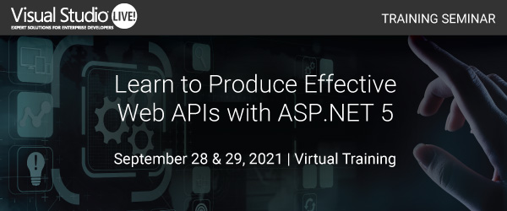
Chris Woodruff
LearningAbout.Dev
Level: Intermediate, etc.

Slide 2

Developing the API Endpoints
Learn to Produce Effective Web APIs with ASP.NET 5

Slide 3
Dependency Injection

Slide 4
Dependency Injection
services.AddScoped<IChinookSupervisor, ChinookSupervisor>();
Services can be registered with one of the following lifetimes:
Lifetime | Details
Transient | Transient lifetime services are created each time they're requested from the service container.
Scoped | Scoped lifetime indicates that services are created once per client request (connection).
Singleton | The first time the service requested. Every subsequent request of the service implementation from the dependency injection container uses the same instance.

Slide 5
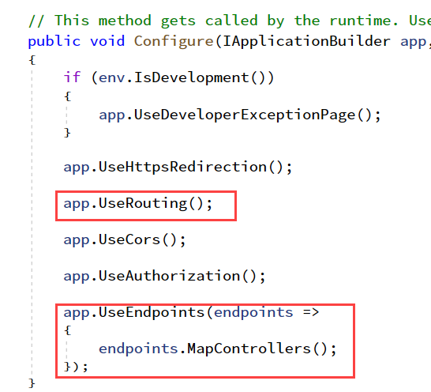
Controllers and Actions : Routing

Slide 6
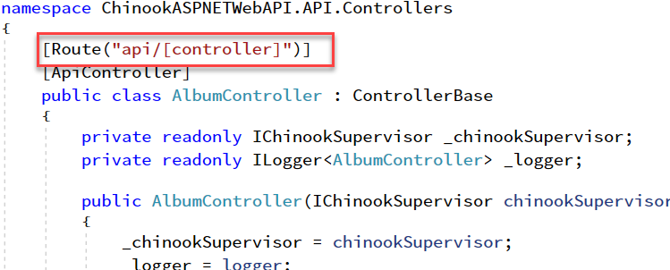
Controllers and Actions : Routing

Slide 7
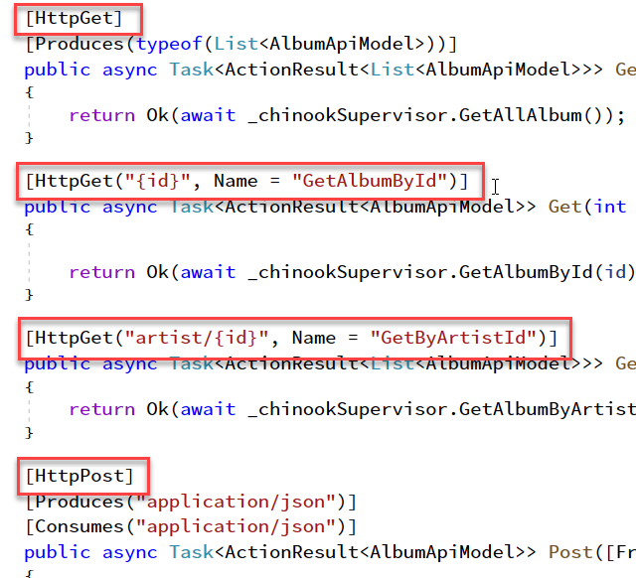
Controllers and Actions: HTTP Verbs

Slide 8
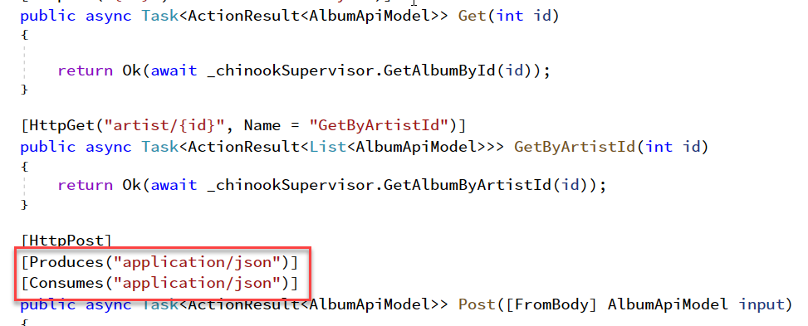
Controllers and Actions: Producing and Consuming

